Slide 1
Cooperative Pathfinding
Written by
David Silver
Presented by
Mohamed Amine Haddaji
Nov 16th,2017
FALL2017
INF7841

Slide 2
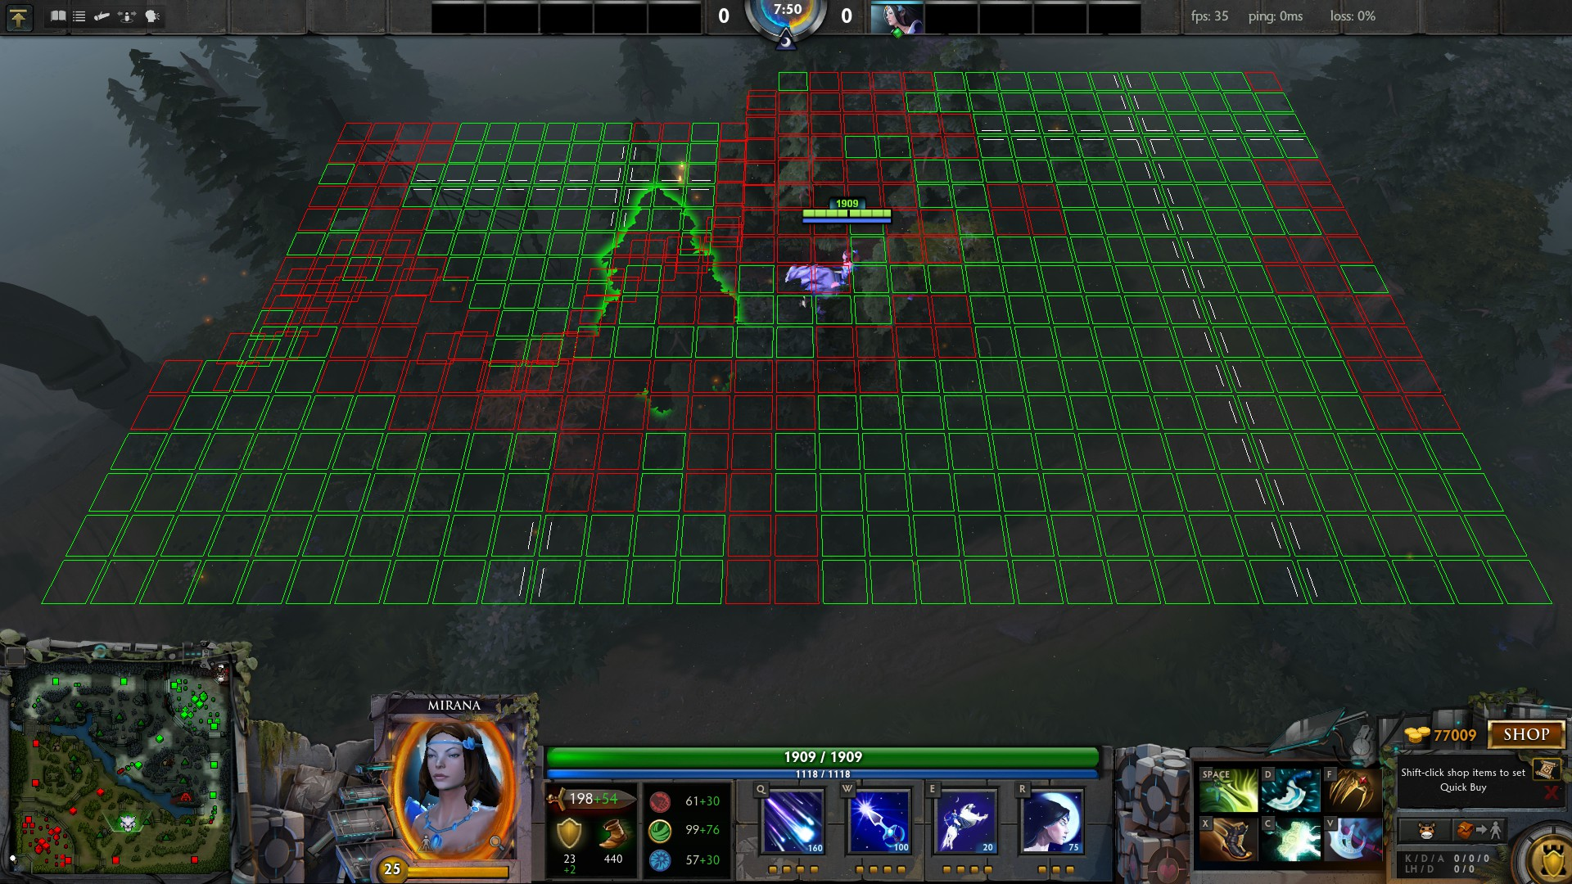
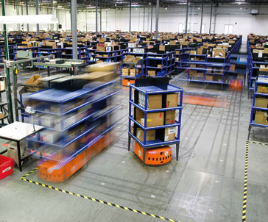
Introduction
Pathfinding algorithms are widely used in video games (especially the A*) and other real-time environments.
Notes:
To start, You probably know that pathfinding algorithms are widely used whether in video games or in other real time environments
1st picture (how the DOTA game engine’s pathfinding algorithm sees the map) 2nd picture shows Amazon fully autonomous robots moving products.
the A* algorithm is it effective ? If not what makes it inadequate.

Slide 3
Issues
“Imagine moving to a new office and you ask everyone to choose a new desk, after taking a good look. You decide to blindfold them. And tell them to get to their desks in the shortest time possible. They might already know a good route to their desks, and how to avoid obstacles. But they haven’t taken under consideration the position of their colleagues .”
Notes:
This example here shows the lack of communication between different agents when searching routes

Slide 4
Local Repair A* (LRA*)
A Local repair A* algorithm is an adapted version of A* with a reroute on demand.
Agents executing a LRA* algorithm ignores all agents except its neighbours.
When a collision is imminent, the algorithm stops and replans the remainder of its route.
Notes:
This is were the idea of a local repair A* algorithm appeared
-
-
-And consider nodes occupied by other agents are blocked

Slide 5
Issues
LRA* algorithm when used in a difficult environments with numerous agents moving around in narrow passage ways can lead to bugs, deadlocks etc.
Bottlenecks can occur in crowded regions and in difficult maps.
If a bottleneck occurs it may take arbitrarily long to be resolved.
Notes:
-
-Bottlenecks can occur in crowded regions and in difficult maps with narrow corridors
-For those who doesn’t know what a bottleneck, it’s where an agent is constantly rerouting in attempt to escape, each time executing the algorithm (loop, circular movements.)
And we’re also still lacking the collaboration between agents.

Slide 6
Cooperative A* (CA*)
The search is divided into a series of single agent searches.
Every search is performed in three dimensional space-time : Cell(x,y,t) (consider the planned routes of other agents)
Each calculated route is placed into a reservation table which is shared between agents.
Notes:
David Silver proposed some new algorithms to fix the non cooperation in the A* and the LRA* algorithms
-Instead of the algorithm executing the search algorithm for all agents at the same time it’s separated into single agent searches, one by one.
-The space map used in A* and LRA* consists of a two-dimensional grid of locations: location(x,y). the space-time map consists of a 3 dimensional grid of sells: Cell(x, y, t)

Slide 7
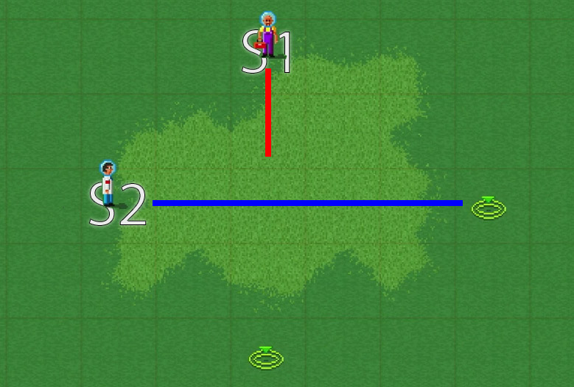
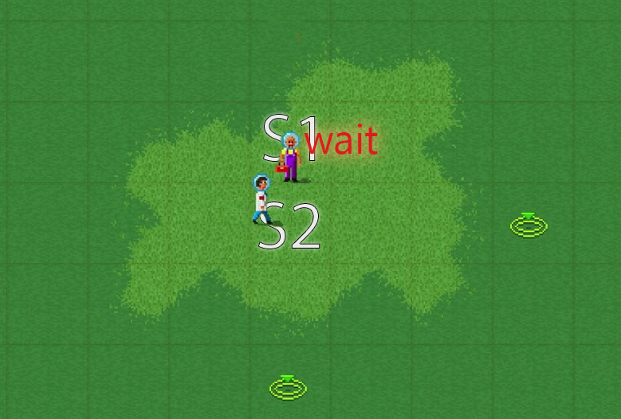
Cooperative A* (CA*)
CA* uses a new action state wait or pause.
Notes:
S1 and S2 trying to reach their destinations, in this case S2 may have started the search before S1 or maybe S2 is faster than S1 so the cube in the middle is occupied by S2 in the reservation table therefore S1 have to wait before passing

Slide 8
Reservation table (How it works)
Once a unit has chosen a path, it needs to make sure that other units know to avoid the cells along its path. This is achieved by marking each cell into a reservation table.
Each entry specifies whether the corresponding cell is available or reserved.
Once an entry is reserved, it is illegal for any other unit to move into that cell. The reservation acts like an obstacle, blocking off a location for a single time-step in the future.

Slide 9
Reservation table
Two units pathfinding cooperatively. (A) The first unit searches for a path and marks it into the reservation table. (B) The second unit searches for a path, taking account of existing reservations , and also marks it into the reservation table.
Notes:
This is just an explanation of how the reservation table works. CA* algo won’t be able to solve this because the two agents will intersect at some point.

Slide 10
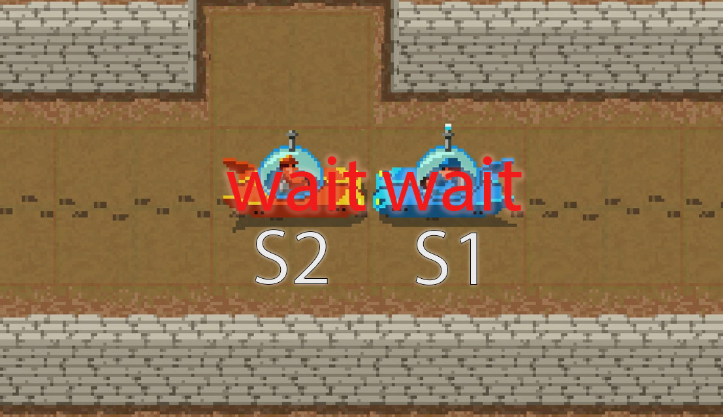
Issues
CA*’s reservation table won’t stop two agents from blocking each other head to head.
Notes:
Unfortunately this simple problem cannot be solved by CA*.

Slide 11
Hierarchical Cooperative A* (HCA*)
Computes the abstract distances on demand.
Ignores all interactions with other agents(they must deviate from their paths to avoid collisions with other agents)
The inaccuracy of the heuristic is determined by the deviation count that the agents must make to avoid interaction with other agents
Notes:
-Since the map is dynamic and the goal can change at anytime the algorithm computes the abstract distances on demand.
-By removing agents from the map and ignoring any possible interaction between them , it gives us perfect estimates of the distance to the destination

Slide 12
Hierarchical Cooperative A* (HCA*)
The path of every agent is planned independently
Uses RRA* to reuse search data in order to maximise the performance.

Slide 13
Reverse Resumable A* (RRA*)
Modified A*. The search starts at the agent’s goal G and heads towards the Agent’s initial position O and won’t terminate when O is reached instead it continues until a specified N is explored.
Whenever an abstract distance is requested from point N to G, RRA* checks if N exists in its closed table. If so the optimal distance is already calculated. If not, the algorithm search is resumed until the node is added to its closed list.

Slide 14
Issues
Once agents reach their destinations, the algorithm stops executing. If the agent’s goal is in a narrow corridor then it may make parts of the map inaccessible for the rest of the agents.
Notes:
The last algorithm that this article covered is WHCA* which trying to fix the problem where agents block the map when they reach their destination.

Slide 15
Windowed Hierarchical Cooperative A* (WHCA*)
It still uses a temporal-spatial search (Reservation table) to know the whereabouts of the agents at all times.
Each agent searches a partial route to its destination (few steps into the future), at regular intervals the window is shifted and a new route is calculated.
The algorithm dynamically vary the agent’s order, so that every agent will have the highest priority for a short period of time.
Notes:
-it still uses the extra 3 dimensional for the time as we saw in the previous algorithms
-instead of searching the route all at once , each agent searches a partial route to its destination, then at predetermined intervals the window is shifted it’s where agents priorities changes and a new route is calculated.
-What’s added to the WHCA*’s algorithm is that it dynamically vary the agents order, so that every agent will have highest priority for a short period of time

Slide 16
Experimental results (David Silver’s experiments)
10 maze like environments 32x32.
impassable obstacles(20% of the maze) , agents and their destinations are randomly placed.
Notes:
According to David Silver’s experiments, when comparing those algorithms in a series of 10 different mazes where 20% of those mazes are impassable obstacles, agents and their destinations are placed randomly across the environment.

Slide 17
Experimental results
Didn’t reach the destination within 100 turns
Collided with another agent
Fail
Reach the destination within the time limit
No collision
Success

Slide 18
Experimental results
Success rate
Notes:
All of the algorithms are able to achieve 100% success rates with low number of agents but with more agents LRA* algorithm struggles and started to fail where only 80% of the agents successfully reached their destinations. While WHCA with window size 16 and 32 stayed with success rates of more than 98%

Slide 19
Experimental results
Initialisation time
Notes:
Cooperative pathfinding algorithms takes time to initialise compared to LRA*

Slide 20
Experimental results
Turn time
Notes:
And also takes more time to calculate the turn time

Slide 21
Conclusion
Cooperative pathfinding is a technique used to fix the non collaboration between agents while planning routes by using a reservation table to communicate their paths.
It gives them the ability to avoid conflicting routes and blocking each other by looking forward in time.
The new algorithms presented in this articles are efficient in terms of finding optimal routes for big amount of agents in tight environments but its requires more computing power therefore more time to get results .
Notes:
- To conclude and end this presentation a cooperative pathfinding is a technique used to fix the non collaboration.
-it’s true that the new algorithms presented in this articles are efficient in terms of finding optimal routes compared with the commonly used A* and LRA*

Slide 22
References
  Silver, David, “Cooperative Pathfinding”, Proceedings of the First Conference on Artificial Intelligence and Interactive Digital Entertainment: pp. 117-122.
  https://www.skilled.io/u/playgroundscon/cooperative-path-finding
  http://www0.cs.ucl.ac.uk/staff/D.Silver/web/Applications_files/coop-path-AIWisdom.pdf

