Slide 1
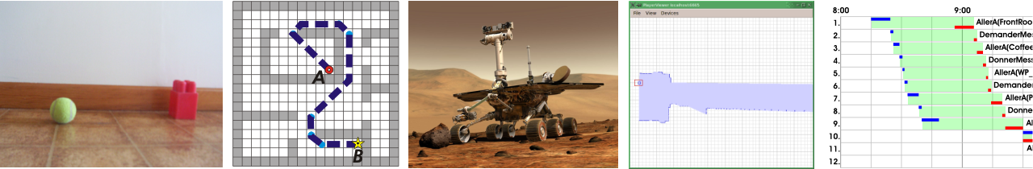
Planning Concurrent Actions under Resources and Time Uncertainty
Éric Beaudry
http://planiart.usherbrooke.ca/~eric/
Étudiant au doctorat en informatique
Laboratoire Planiart
27 octobre 2009 – Séminaires Planiart

Slide 2
Plan
Sample Motivated Application: Mars Rovers
Objectives
Literature Review
  Classic Example A*
  Temporal Planning
  MDP, CoMDP, CPTP
  Forward chaining for resource and time planning
  Plans Sampling approaches
Proposed approach
  Forward search
  Time bounded to state elements instead of states
  Bayesian Network with continuous variable to represent time
  Algorithms/Representation: Draft 1 to Draft 4
Questions

Slide 3
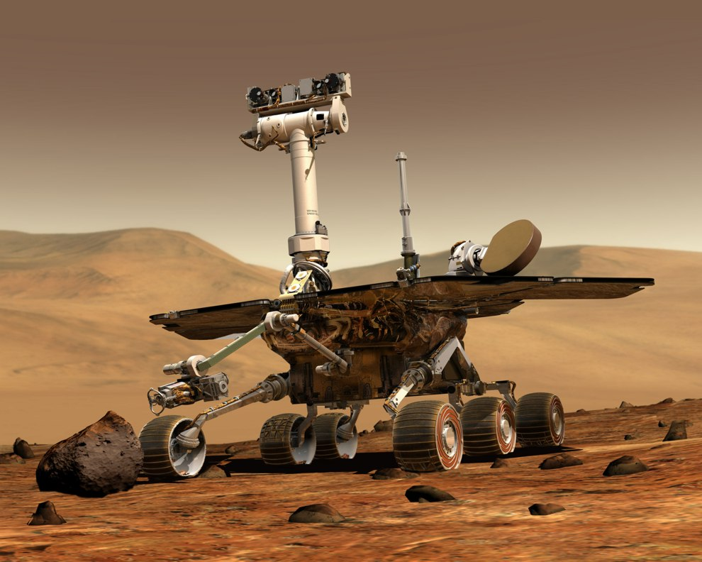
Mission Planning for
Mars Rovers
Image Source : http://marsrovers.jpl.nasa.gov/gallery/artwork/hires/rover3.jpg
Sample application

Slide 4
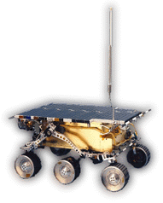


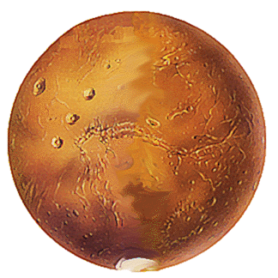
Mars Rovers: Autonomy is required
Robot Sejourner
> 11 Minutes * Light

Slide 5
Mars Rovers: Constraints
Navigation
  Uncertain and rugged terrain.
  No geopositioning tool like GPS on Earth. Structured-Light (Pathfinder) /
  Stereovision (MER).
Energy.
CPU and Storage.
Communication Windows.
Sensors Protocols (Preheat, Initialize, Calibration)
Cold !

Slide 6
Mars Rovers: Uncertainty (Speed)
Navigation duration is unpredictable.
5 m 57 s
14 m 05 s

Slide 7
Mars Rovers: Uncertainty (Speed)
robot
robot

Slide 8
Mars Rovers: Uncertainty (Power)
Required Power by motors → Energy Level
Power
Power
Power

Slide 9
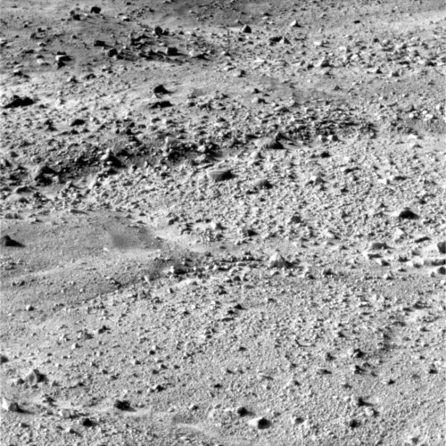
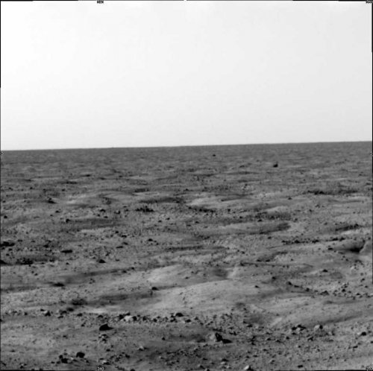
Mars Rovers: Uncertainty (Size&Time)
Lossless compression algorithms have highly variable compression rate.
Image size : 1.4 MB
Time to Transfer: 12m42s
Image size : 0.7 MB
Time to Transfer : 06m21s

Slide 10
Mars Rovers: Uncertainty (Sun)
Sun
Sun
Normal
Vector
Normal
Vector

Slide 11
Objectives

Slide 12
Goals
Generating plans with concurrent actions under resources and time uncertainty.
Time constraints (deadlines, feasibility windows).
Optimize an objective function (i.e. travel distance, expected makespan).
Elaborate a probabilistic admissible heuristic based on relaxed planning graph.

Slide 13
Assumptions
Only amount of resources and action duration are uncertain.
All other outcomes are totally deterministic.
Fully observable domain.
Time and resources uncertainty is continue, not discrete.

Slide 14
Dimensions
Effects: Determinist vs Non-Determinist.
Duration: Unit (instantaneous) vs Determinist vs Discrete Uncertainty vs Probabilistic (continue).
Observability : Full vs Partial vs Sensing Actions.
Concurrency : Sequential vs Concurrent (Simple Temporal) [] vs Required Concurrency.

Slide 15
Literature review

Slide 16
Existing Approaches
Planning concurrent actions
  F. Bacchus and M. Ady. Planning with Resource and Concurrency : A Forward Chaining Approach. IJCAI. 2001.
MDP : CoMDP, CPTP
  Mausam and Daniel S. Weld. Probabilistic Temporal Planning with Uncertain Durations. National Conference on Artificial Intelligence (AAAI). 2006.
  Mausam and Daniel S. Weld. Concurrent Probabilistic Temporal Planning. International Conference on Automated Planning and Scheduling. 2005
  Mausam and Daniel S. Weld. Solving concurrent Markov Decision Processes. National Conference on Artificial intelligence (AAAI). AAAI Press / The MIT Press. 716-722. 2004.
Factored Policy Gradient : FPG
  O. Buffet and D. Aberdeen. The Factored Policy Gradient Planner. Artificial Intelligence 173(5-6):722–747. 2009.
Incremental methods with plan simulation (sampling) : Tempastic
  H. Younes, D. Musliner, and R. Simmons. « A framework for planning in continuous-time stochastic domains. International Conference on Automated Planning and Scheduling (ICAPS). 2003.
  H. Younes and R. Simmons. Policy generation for continuous-time stochastic domains with concurrency. International Conference on Automated Planning and Scheduling (ICAPS). 2004.
  R. Dearden, N. Meuleau, S. Ramakrishnan, D. Smith, and R. Washington. Incremental contingency planning. ICAPS Workshop on Planning under Uncertainty. 2003.

Slide 17
Families of Planning Problems with Actions Concurrency and Uncertainty
Non-Deterministic (General Uncertainty)
FPG [Buffet]
+ Durative Action
CPTP [Mausam]
+ Deterministic
+ Continuous Action Duration Uncertainty
[Dearden]
+ Action Concurrency
CoMDP [Mausam]
+ Action Concurrency
[Beaudry]
Tempastic [Younes]
+ Deterministic
Action Duration
A*+PDDL with durative
= Temporal Track of ICAPS/IPC
A* + PDDL 3.0 with durative actions
+ Forward chaining [Bacchus&Ady]
Sequence of Instantaneous
Actions (unit duration)
MDP
Classical Planning
A* + PDDL

Slide 18
Families of Planning Problems with Actions Concurrency and Uncertainty
Fully Non-Deterministic (Outcome + Duration) + Action Concurrency
FPG [Buffet]
+ Deterministic Outcomes
[Beaudry] [Younes]
+ Sequential (no action concurrency)
[Dearden]
+ Discrete Action
Duration Uncertainty
CPTP [Mausam]
+ Deterministic
Action Duration
= Temporal Track
at ICAPS/IPC
Forward Chaining
[Bacchus]
+ PDDL 3.0
+ Longest Action
CoMDP [Mausam]
MDP
Classical Planning
A* + limited PDDL
The + sign indicates constraints on domain problems.

Slide 19
Required Concurrency (DEP planners are not complete!)
Domains with required concurrency
PDDL 3.0
Mixed [To be validated]
At limited subset of PDDL 3.0
DEP (Decision Epoach Planners)
TLPlan
SAPA
CPTP
LPG-TD
…
Simple Temporal
Concurrency is to reduce makespan

Slide 20
Transport Problem
Initial State
Goal State
r₁
r₂
r₃
r₄
r₁
r₂
r₃
r₄
r₅
r₆
r₅
r₆
robot
robot

Slide 21
Classical Planning (A*)
Goto(r5,r1)
Goto(r5,r2)
…
Take(…)
…
…
…
…
Goto(…)
…
…
…

Slide 22
Classical Planning
Goto(r5, r1)
…
Goto(r1, r5)
Temporal Planning : add current-time to states
Goto(r5, r1)
Goto(r1, r5)
Time=0
Time=60
Time=120

Slide 23
Concurrent Mars Rover Problem
Goto(a, b)
InitializeSensor()
AcquireData(p)
at begin:
robotat(a)
over all:
link(a, b)
atbegin:
not initialized()
over all:
at(p)
initialized()
Preconditions
Preconditions
Preconditions
at begin:
not at(a)
at end:
at(b)
at end:
initialized()
at end:
not initialized()
hasdata(p)
Effets
Effets
Effets

Slide 24
Forward chaining for concurrent actions planning
Initial State
Goal State
r₁
r₂
r₃
r₄
r₁
r₂
r₃
r₄
r₅
r₆
r₅
r₆
robot
Camera (Sensor) is not initialized.
has
Picture r2 .
robot

Slide 25
Action Concurrency Planning
Time=0
Time=0
InitCamera()
Position=undefined
Position=undefined
Goto(r5,r2)
90: Initialized=True
120: Position=r2
État initial
120: Position=r2
…
Time=0
Position=r5
Time=0
Position=undefined
…
Goto(c1, r3)
150: Position=r3
Goto(c1, p1)
InitCamera()
Time=0
Time=90
Position=r5
Position=r5
Initialized=True
$AdvTemps$
90: Initialized=True
…
…

Slide 26
(Suite)
Time=0
Time=0
Position=undefined
Initialized=False
InitCamera()
Position=undefined
Initialized=False
Initial State
Goto(r5, r2)
90: Initialized=True
120: Position=r2
…
120: Position=r2
Time=0
Position=r5
Initialized=False
$AdvTemps$
Time=90
Position=undefined
Initialized=True
120:+ Position=r2
$AdvTemps$
Time=130
Time=120
Time=120
Position=r2
Initialized=False
HasPicture(r2)
$AdvTemps$
Position=r2
TakePicture()
Position=r2
Initialized=True
130: HasPicture(r2)=True
130: Initialized=False
[120,130] Position=r2

Slide 27
Extracted Solution Plan
Goto(r5, r2)
InitializeCamera()
TakePicture(r2)
0
40
60
90
120
Time (s)

Slide 28
Markov Decision Process (MDP)
25 %
70 %
Goto(r5,r1)
Goto(r5,r1)
5 %
Goto(r5,r1)

Slide 29
Concurrent MDP (CoMDP)
New macro-action set : Ä = {ä∈2^{A} | ä is consistent}
Also called “combined action”.
Goto(a, b)+InitSensor()
Goto(a, b)
InitializeSensor()
atbegin:
not initialized()
at begin:
robotat(a)
not initialized()
over all:
link(a, b)
at begin:
robotat(a)
over all:
link(a, b)
Preconditions
Preconditions
Preconditions
at begin:
not at(a)
at end:
at(b)
at end:
initialized()
Effets
Effets
at begin:
not at(a)
at end:
at(b)
initialized()
Effets
Notes:
Quand la durée est considérée, la macro-action a la durée de la plus longue sous-action.

Slide 30
Mars Rovers with Time Uncertainty
Goto(a, b)
InitializeSensor()
AcquireData(p)
at begin:
robotat(a)
over all:
link(a, b)
atbegin:
not initialized()
over all:
at(p)
initialized()
Preconditions
Preconditions
Preconditions
at begin:
not at(a)
at end:
at(b)
at end:
initialized()
at end:
not initialized()
hasdata(p)
Effets
Effets
Effets
25% : 90s
50% : 100s
25% : 110s
50% : 20s
50% : 30s
50% : 20s
50% : 30s
Duration
Duration
Duration

Slide 31
CoMPD – Combining Outcomes
MDP
CoMDP
T=90
Pos=B
Goto(A, B)
25%
{ Goto(A,B), InitSensor() }
T=0
Pos=A
T=100
Pos=B
T=90
Pos=B
Init=T
50%
25%
25%
T=110
Pos=B
T=0
Pos=A
Init=F
T=100
Pos=B
Init=T
50%
25%
InitSensor()
T=20
Pos=A
Init=T
T=110
Pos=B
Init=T
50%
T=0
Pos=A
Init=F
50%
T=30
Pos=A
Init=T
T: Current-Time
P: Robot’s Position
Init : Is the robot’s sensor initialized?

Slide 32
CoMDP Solving
A CoMDP is also a MDP.
State space if very huge:
  Action set is the power set Ä = {ä∈2^{A} | ä is consistent}.
  Large number of actions outcomes.
  Current-Time is a member of state.
Algorithms like value and policy iteration are too limited.
Require approximative solution.
Planner by [Mausam 2004]:
  Labeled Real-Time Dynamic Programming (Labeled RTDP) [Bonet&Geffner 2003] ;
  Actions prunning:
    Combo Skipping + Combo Elimination [Mausam 2004].

Slide 33
Concurrent Probabilistic Temporal Planning (CPTP) [Mausam2005,2006]
CPTP combines CoMDP et [Bachus&Ady 2001].
Exemple : A->D, C->B
CoMDP
CPTP
A
B
A
D
C
D
C
B
0
1 2 3 4 5 6 7 8
0
1 2 3 4 5 6 7 8

Slide 34
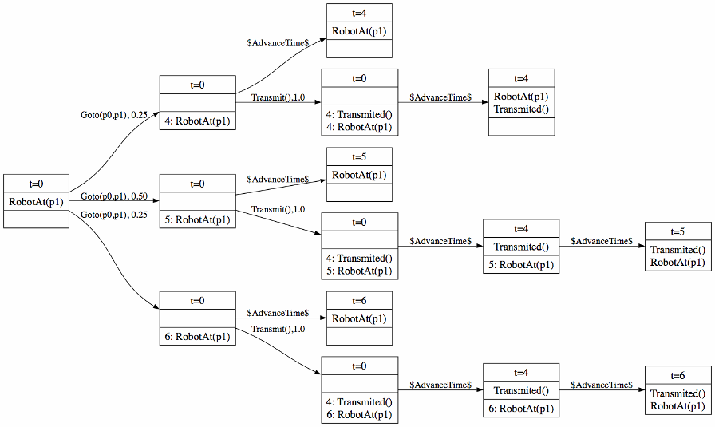
CPTP search graph

Slide 35
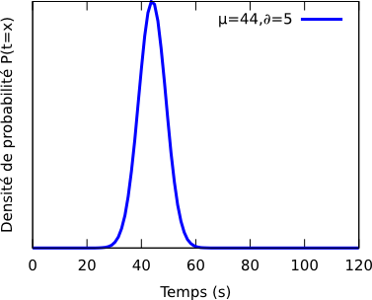
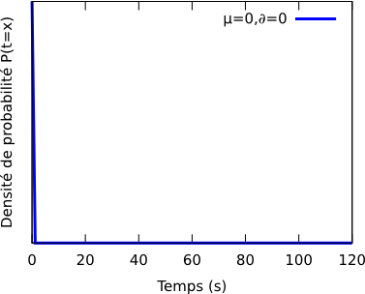
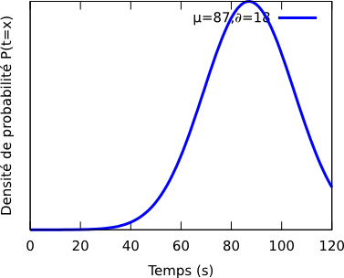
Continuous Time Uncertainty
Position=r1
Goto(r5,r1)
Position=r5
Position=r3
Goto(r5,r3)
r1
r2
r3
r4
r5
r6

Slide 36
Continuous
Uncertainty
Position=r1
Position=r5
Position=r1
Goto(r5,r1)
Discrete
Uncertainty
Position=r1
Time=36
5 %
Goto(r5,r1)
Position=r1
Time=40
20 %
Position=r5
Time=0
Position=r1
Time=44
50 %
Position=r1
Time=48
20 %
Position=r1
Time=52
5 %

Slide 37
Generate, Test and Debug [Younes and Simmons]
Initial Problem
Deterministic Planner
Plan
Plan Tester
(Sampling)
Goals
Plan
Failures Points
Partial Problem
Initial State
Pending
Goals
Selection of a
Branching Point
Conditional Plan
Intermediate State

Slide 38
Generate, Test and Debug
Initial State
Goal State
r₁
r₂
r₃
r₄
r₁
r₂
r₃
r₄
r₅
r₆
r₅
r₆
robot
Plan
At r2 before time t=300
Goto r1
Load
Goto r2
Unload
Load
Goto r3
Unload
0
Time (s)
150
300
Sampling
0
150
300

Slide 39
Goto r1
Load
Goto r2
Unload
Load
Goto r3
Unload
0
150
300
Time (s)
0
150
300
Initial State
Goal State
Selection of a
Branching Point
r₁
r₂
r₃
r₄
r₁
r₂
r₃
r₄
robot
r₅
r₆
r₅
r₆
Partial Plan
Goto r1
Load
Deterministic Planner
Partial End Plan
Concatenation

Slide 40
Incremental Planning
Generate, Test and Debug [Younes]
  Random Points.
Incremental Planning
  Predict a cause of failure point by GraphPlan.

Slide 41
Efficient planning concurrent actions with time uncertainty
New approach

Slide 42
Draft 1: Problems with Forward Chaining
Initial State
Time=0
Time=0
Time=0
Position=r5
Initialized=False
Goto(r5, r2)
Position=undefined
Initialized=False
InitCamera()
Position=undefined
Initialized=False
90: Initialized=True
120: Position=r2
120: Position=r2
$AdvTemps$
If Time is uncertain, we cannot put scalar values into states.
We should use random variables.
Time=90
Position=undefined
Initialized=True
120: Position=r2

Slide 43
Draft 2: using random variables
Initial State
Time=0
Time=0
Time=0
Position=r5
Initialized=False
Goto(r5, r2)
Position=undefined
Initialized=False
InitCamera()
Position=undefined
Initialized=False
d2: Initialized=True
d1: Position=r2
d1: Position=r2
AdvTemps d1 or d2?
What happend if d1 and d2 overlap?
Time=d2
Position=undefined
Initialized=True
d1: Position=r2

Slide 44
Draft 3: putting time on state elements (Deterministic)
Initial State
0: Position=r5
0: Initialized=False
120: Position=r2
0: Initialized=False
Goto(r5, r2)
InitCamera()
120: Position=r2
90: Initialized=True
TakePicture()
Each state element has a bounded time.
Do not require special advance time action.
Over all conditions are implemented by a lock (similar to Bacchus&Ady).
120: Position=r2
90: Initialized=True
130: HasPicture(r2)
Lock until 130:
Initialized=True
Position=r2

Slide 45
Draft 4 (Probabilistic Durations)
Initial State
t0: Position=r5
t0: Initialized=False
Goto(r5, r2)
d1
t1=t0+d1: Position=r2
t0: Initialized=False
t1: Position=r2
t2=t0+d2: Init=True
InitCamera()
d2
t0
d2
d2=N(30,5)
TakePicture()
d4
d1
t0=0
d1=N(120,30)
t1
t1: Position=r2
t2: Initialized=True
t4: HasPicture(r2)
t1=t0+d1
t2
t2=t0+d2
Lock until t3 to t4:
Initialized=True
Position=r2
t3
t3=max(t1,t2)
d4
d4=N(30,5)
Probabilistic Time Net
(Bayesian Network)
t4
t4=t3+d4

Slide 46
Bayesian Network Inference
Inference = making a query (getting distribution of a node)
Exact methods work for BN constrained to:
  Discrete Random Variables
  Linear Gaussian Continuous Random Variables
Max and Min functions are not linear functions ☹
All others BN have to use approximate inference methods.
  Mostly based on Monte-Carlo sampling
  Question: since it requires sampling, what is the difference with [Younes&Simmons] and [Dearden] ?
References:
  BN books...

Slide 47
Comparaison

Slide 48
For a next talk
Algorithm
How to test goals
Heuristics (relaxed graph)
Metrics
Resource Uncertainty
Results (benchmarks on modified ICAPS/IPC)
Generating conditional plans
…

Slide 49


Questions
Merci au CRSNG et au FQRNT pour leur support financier.

